Slide 1


ROHIT SELOKAR
CAPSTONE PROJECT
LIBRARY MANAGEMENT SYSTEM

Slide 2
KEY TECHNOLOGIES
Angular: A popular framework for building dynamic, single-page web applications using TypeScript and HTML.
Tailwind CSS: A utility-first CSS framework for building custom designs quickly with responsive layouts.
Java: A widely-used programming language known for its platform independence and object-oriented approach.
Spring Boot helps to write backend code by providing a streamlined and efficient framework for building web applications and services, with minimal configuration and setup.
MySQL: An open-source relational database management system used to store and manage data.
JDBC: Java Database Connectivity (JDBC) is an API that enables Java applications to interact with databases for querying and updating data.

Slide 3
TECHNOLOGY USED
FRONTEND : ANGULAR, TAILWINDCSS
BACKEND : SPRINGBOOT
DATABASE : MYSQL

Slide 4
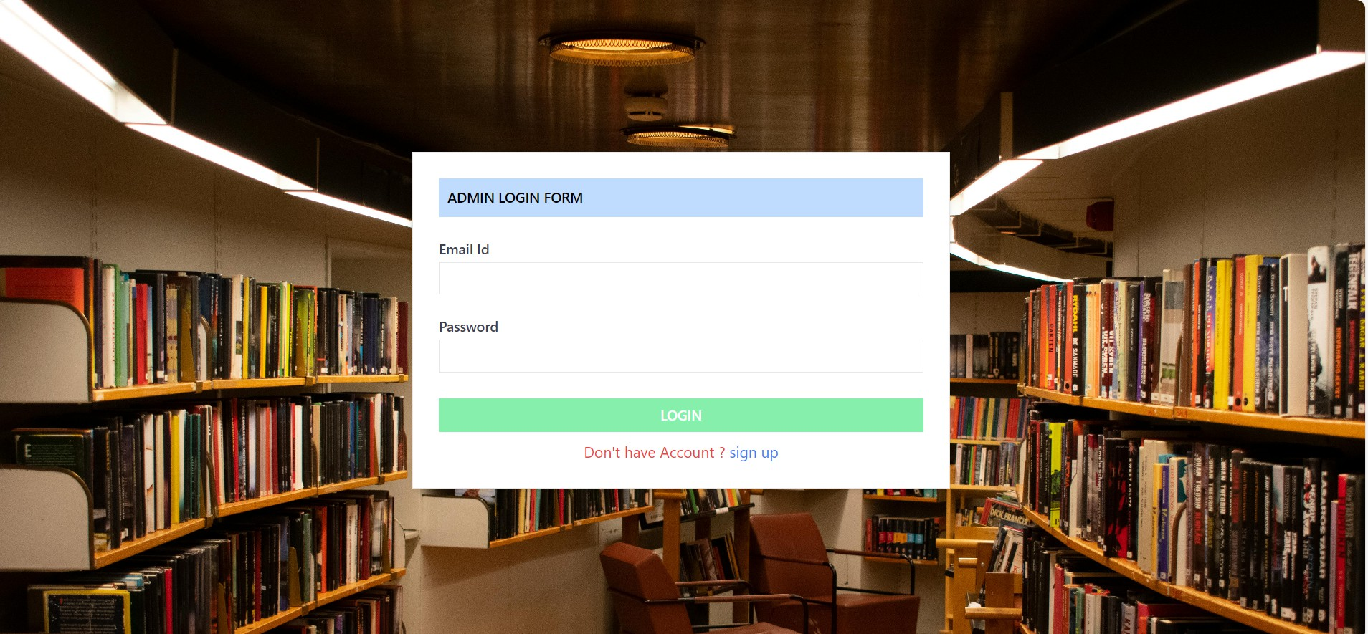
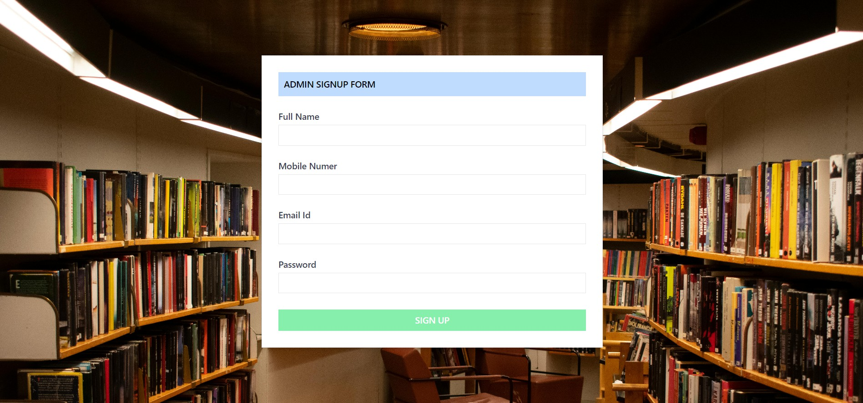
LOGIN & SIGNUP FORM
Admins can sign up and log in using their email and password.
Three failed login attempts lock the account for 30 minutes.

Slide 5
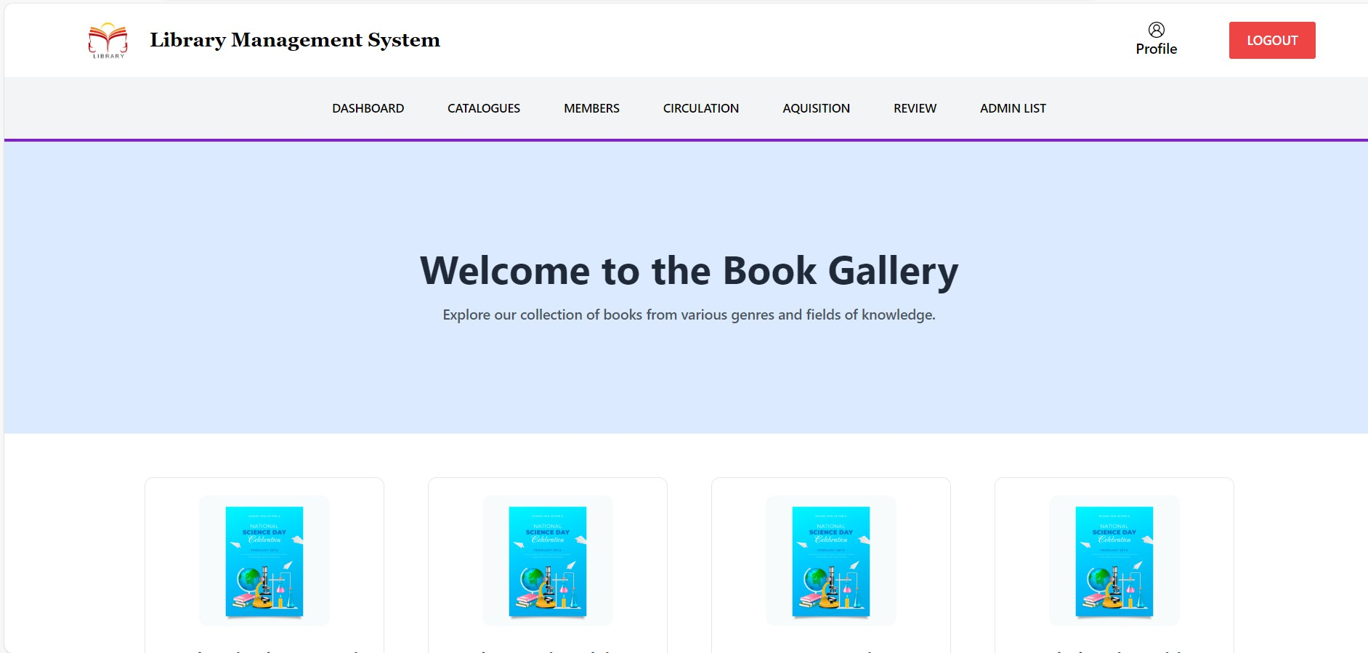
HOME PAGE
After a successful login, the admin is navigated to the home page.
The home page features a navbar with options like Dashboard, Catalogues, Members, Circulation, Acquisition, Review, and Admin List for easy navigation.

Slide 6
COMPONENTS
Dashboard: Displays an overview of library statistics, including total members, catalogues, and circulation activity.
Catalogues: Allows administrators to manage books and resources, including adding, viewing, searching, updating, and deleting entries.
Members: Facilitates the management of library members with features to add, search, view, update, and delete member details.
Circulation: Tracks borrowing and returning of books, including updating statuses and recording borrow/return dates.
Review: Collects and displays feedback or reviews provided by members about library services or the books.
Admin List: Displays all registered admins with options for super admin to delete or manage admin accounts.

Slide 7
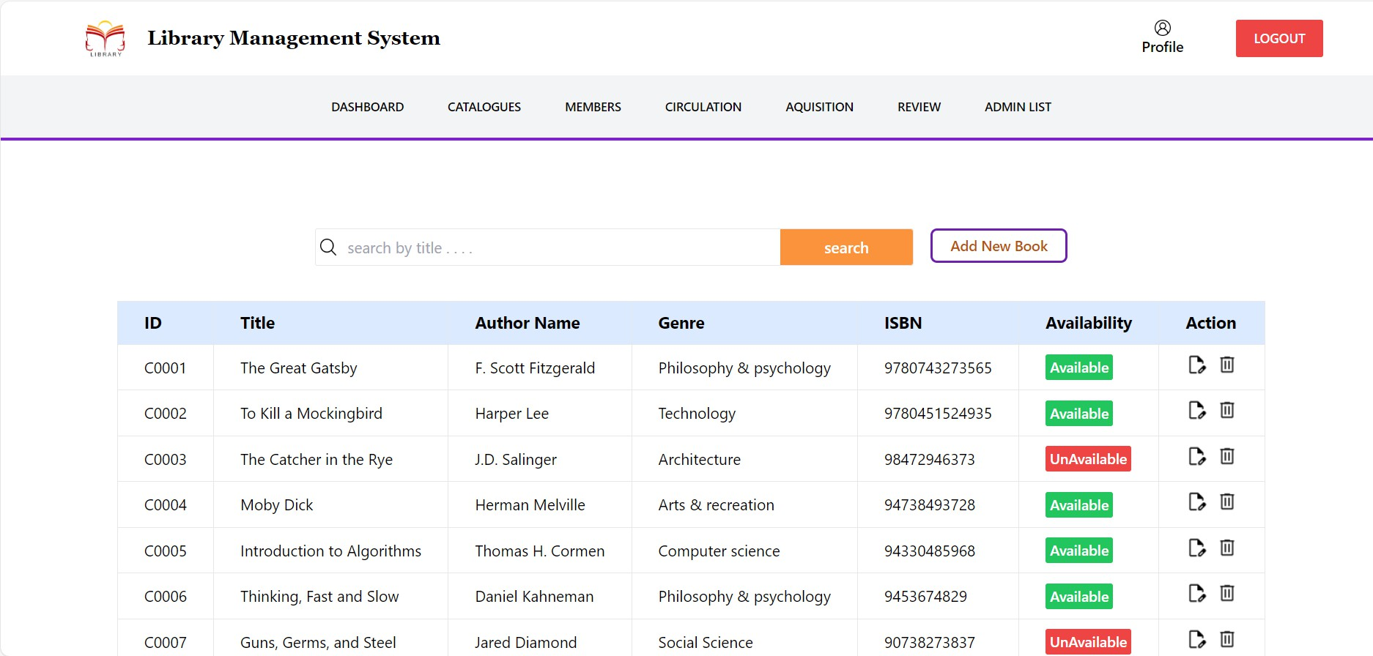
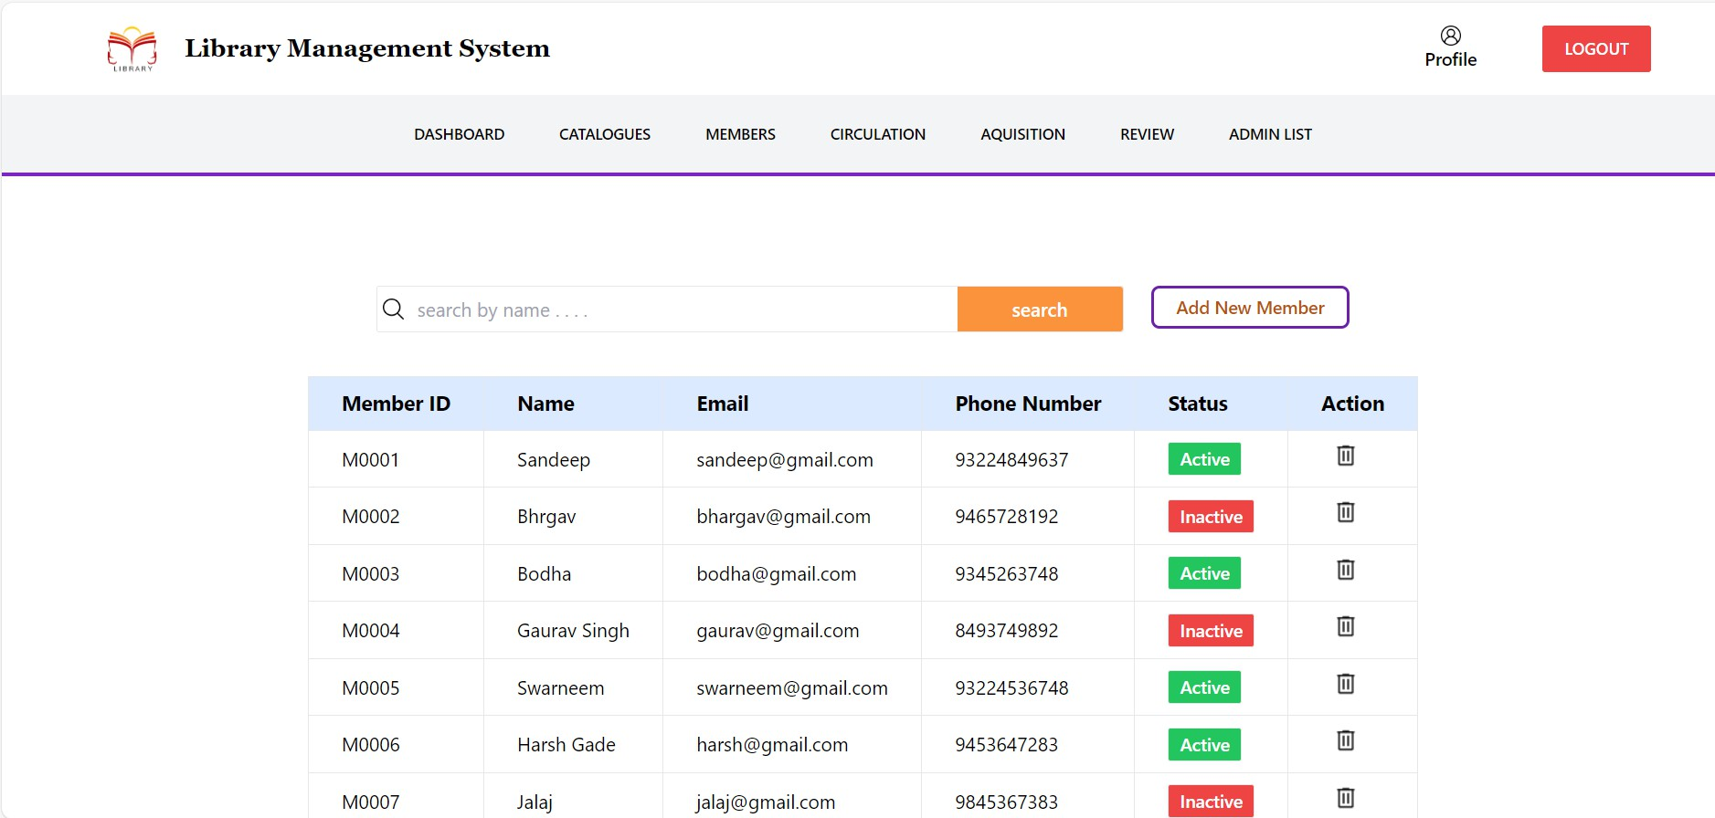

Slide 8
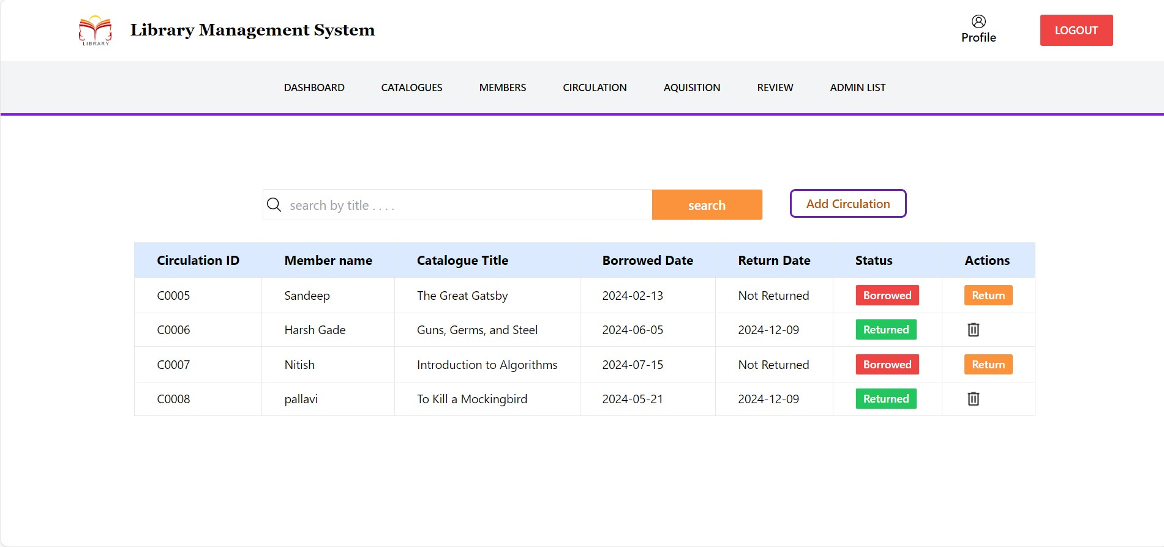
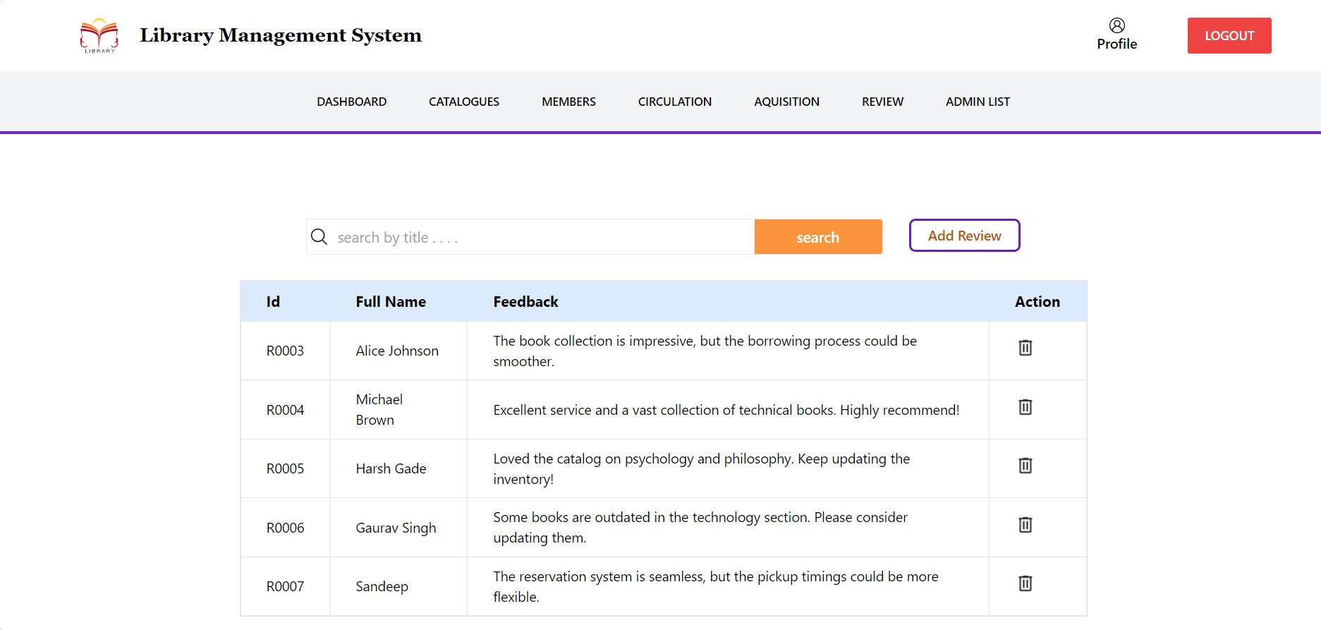

Slide 9
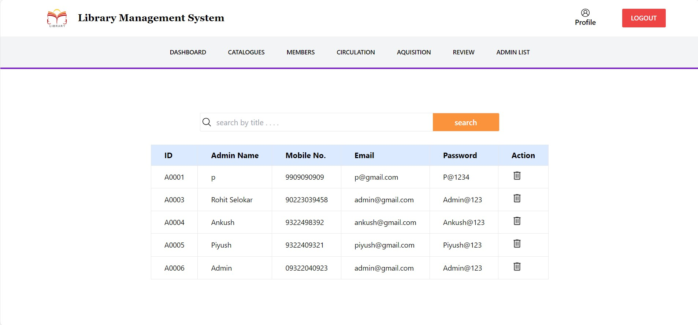
ADMIN LIST

Slide 10
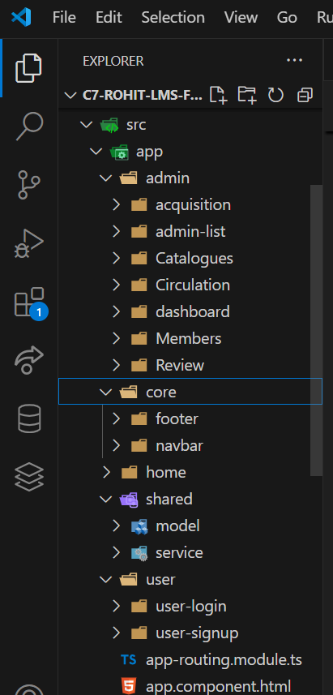
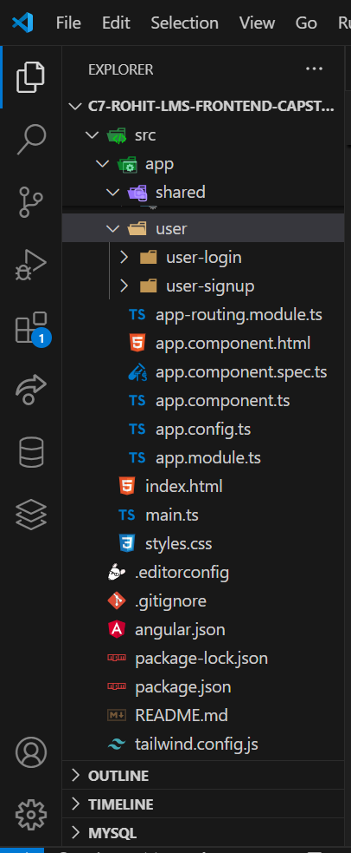
FOLDER STRUCTURE
FRONTEND

Slide 11
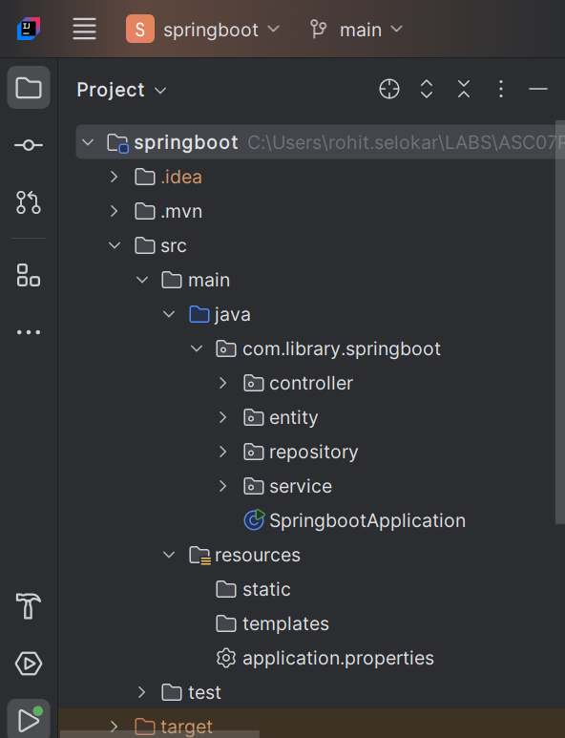
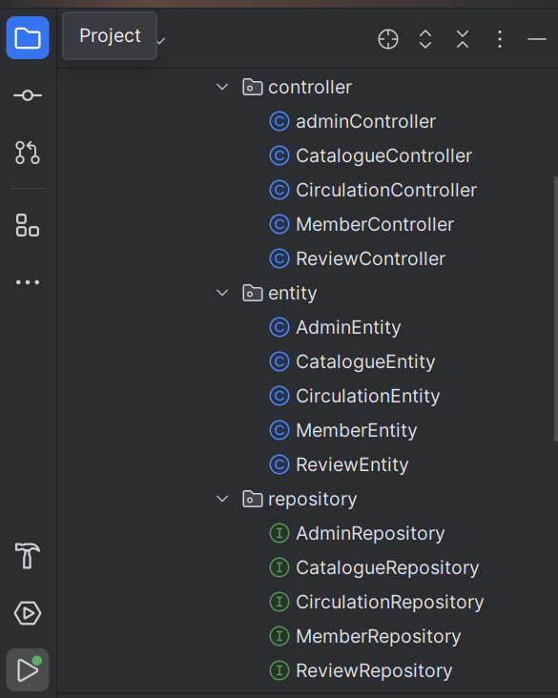
FOLDER STRUCTURE
BACKEND

Slide 12
Challenges I Faced.
Complex Relationships: Managing foreign keys to ensure consistency between catalogues, members, and circulations.
Data Validation and Security: Implementing secure authentication and data validation in Spring Boot.
Mapping Frontend with Backend: Integrating Angular with Spring Boot APIs for seamless data flow.

Slide 13
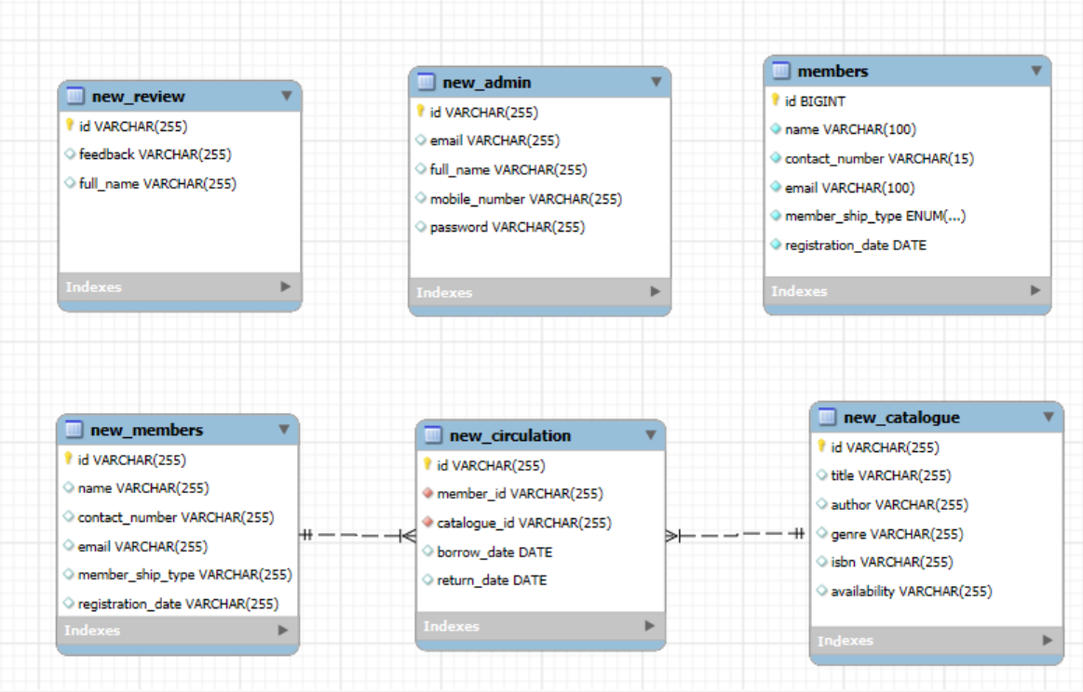
ER DIAGRAM

Slide 14
Additional Features
Tailwind CSS: Used for designing a modern, clean, and utility-first user interface.
Responsive Website: Ensures optimal user experience across all device sizes and screen resolutions.
Primary Key: Uniquely identifies each record in the database tables for efficient data management.
Foreign Key: Establishes relationships between tables to maintain data integrity and consistency.
React Website: Utilized for creating a dynamic and interactive version of the Library Management.

Slide 15
THANK YOU

